Slide 1


CR3 – PFAS Decontamination Service
JULY 31ST, 2025

Slide 2

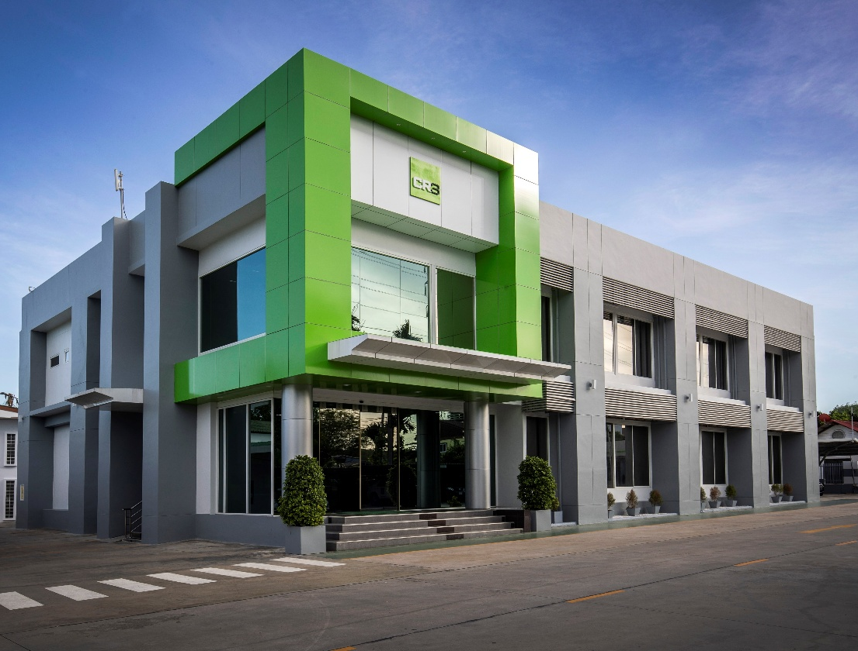

AGENDA
CR3 Service Capability
PFAS Decontamination for Firefighting System
Questions & Wrap-up

Slide 3
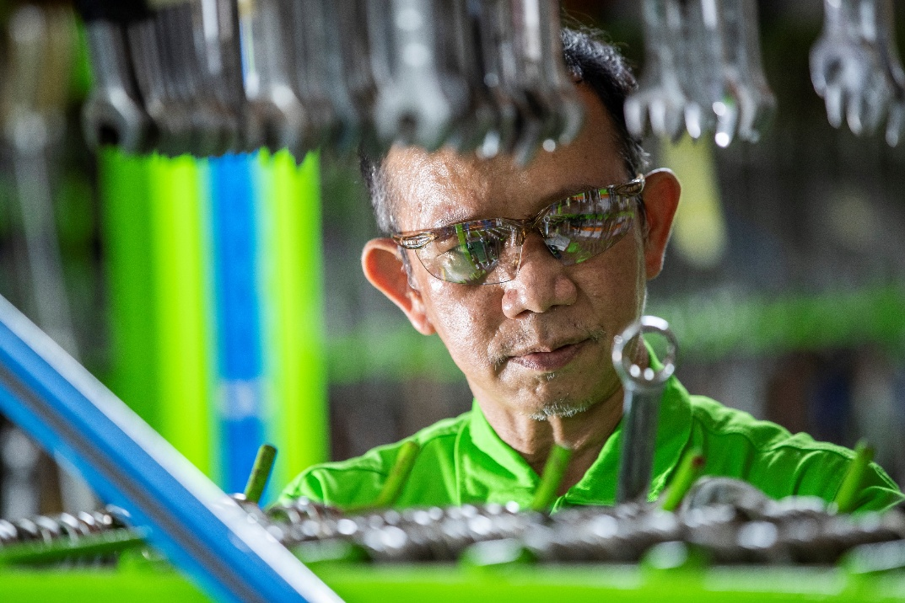
CR3 GROUP Competency Experience
We work on every Refinery, Petrochemical plant and Offshore Asset in Thailand/Vietnam/Myanmar and many more throughout the Asian region.
Major Contractor to support maintenance activity in Thailand
40 Term Contracts covering wide range of maintenance services throughout Thailand/Vietnam and neighboring countries.
Specialist in Chemical Cleaning and Decontamination Service

Slide 4
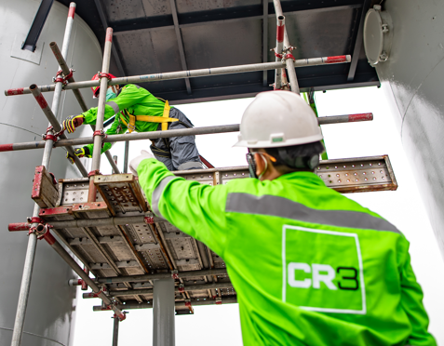
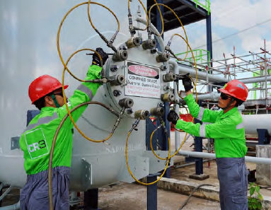
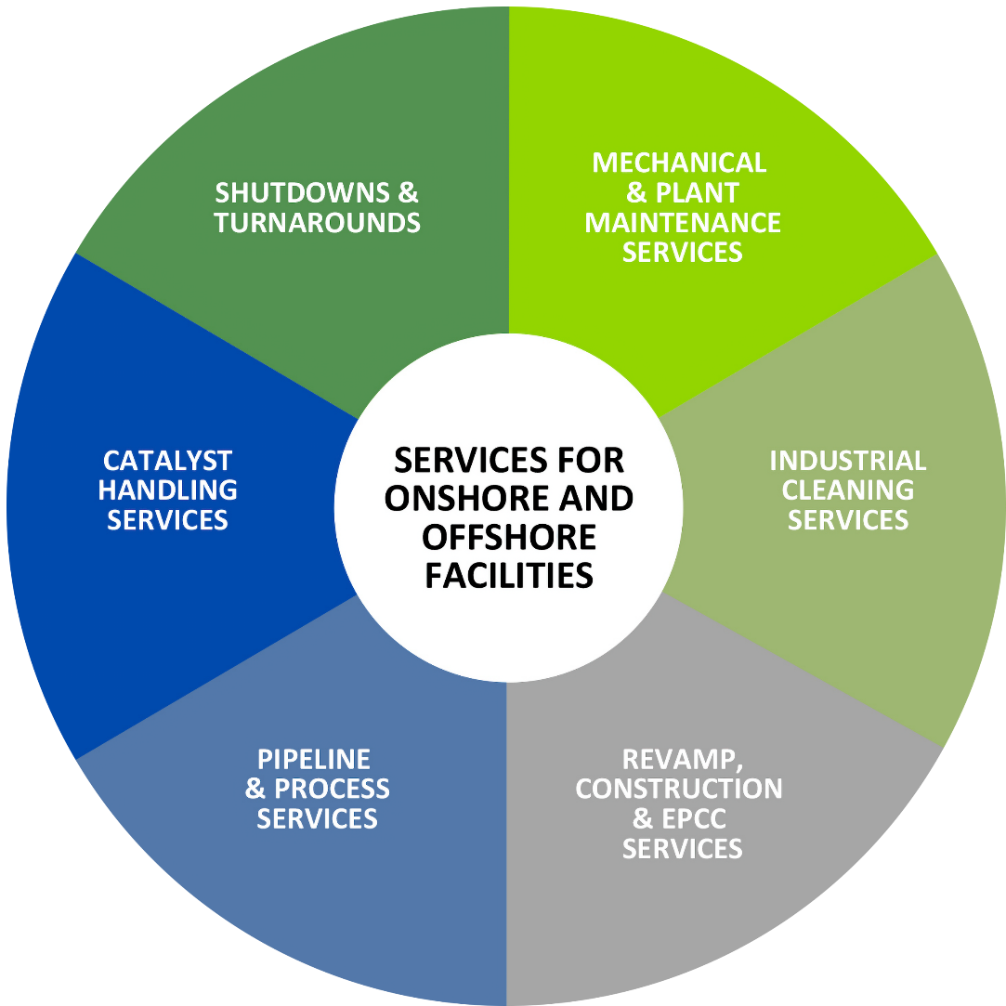
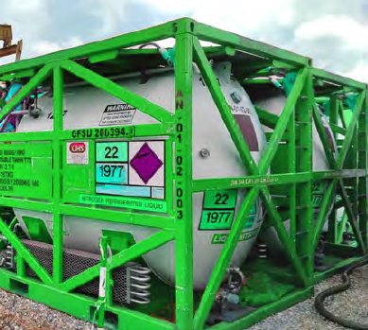
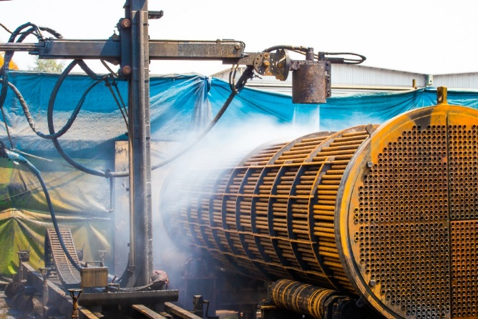
CR3 SERVICES

Slide 5
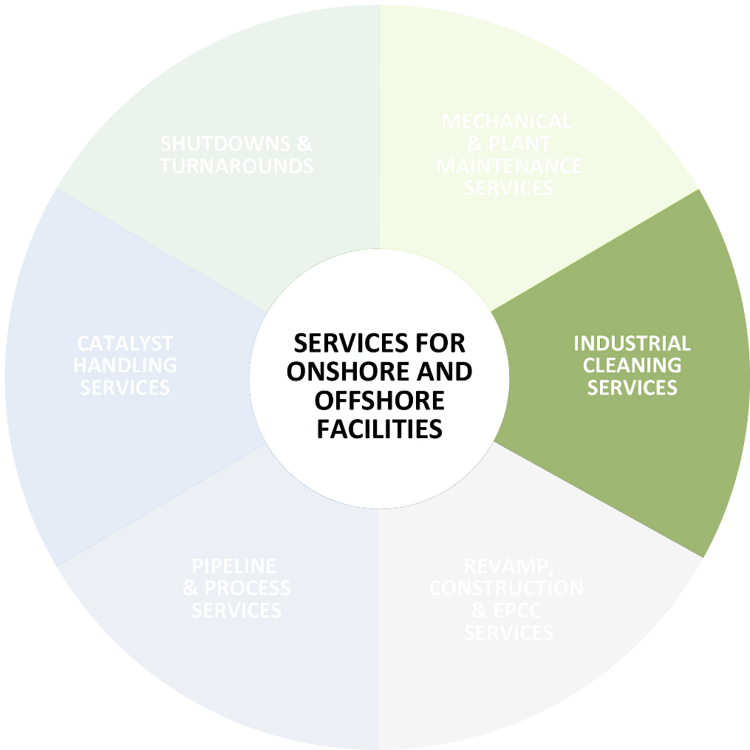
INDUSTRIAL CLEANING SERVICES
Our extensive portfolio of cleaning services sets the technical, environmental and safety standards benchmark.
RELATED SERVICES
Chemical Cleaning Services
Mercury Management Services
Fin Fan Optimisation
Hydro Jetting Services
CR3 Decoking Technology (CDT)
Decontamination Services
Waste Handling

Slide 6

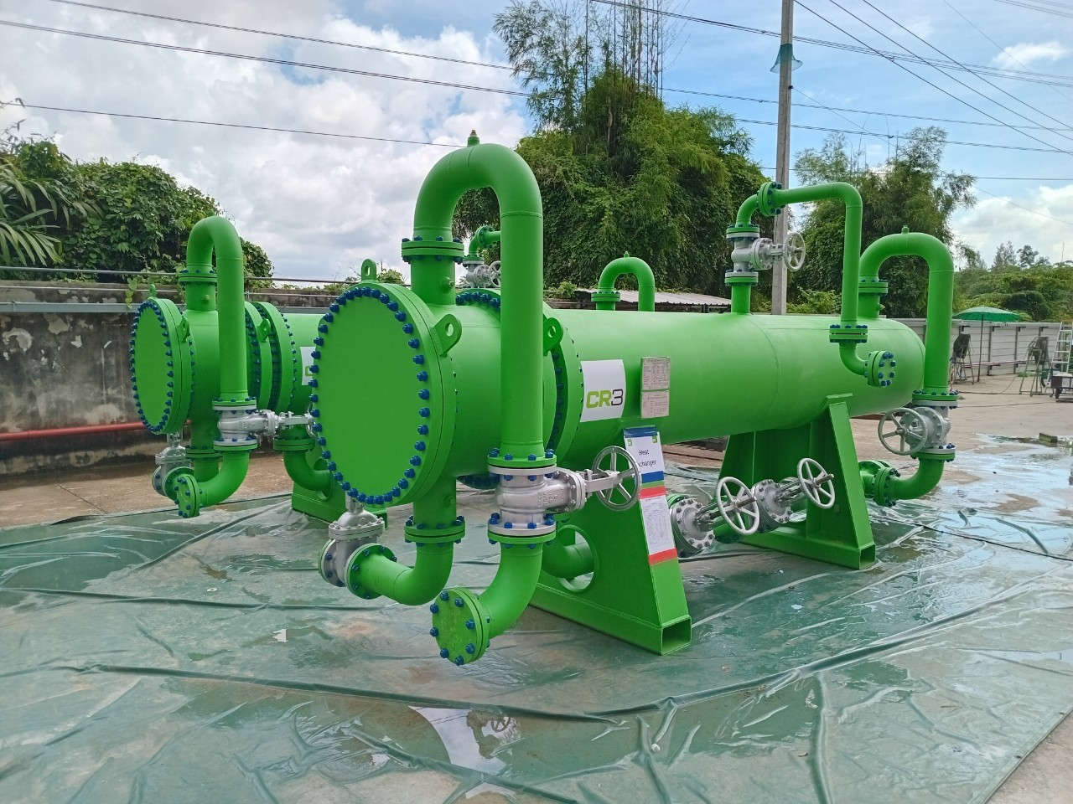
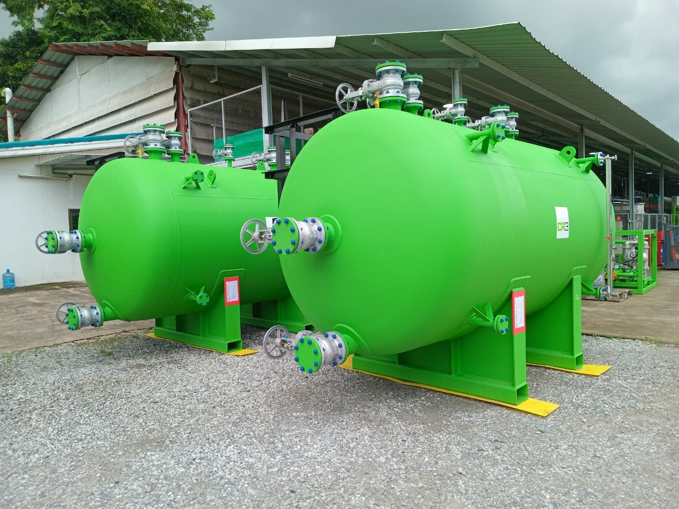
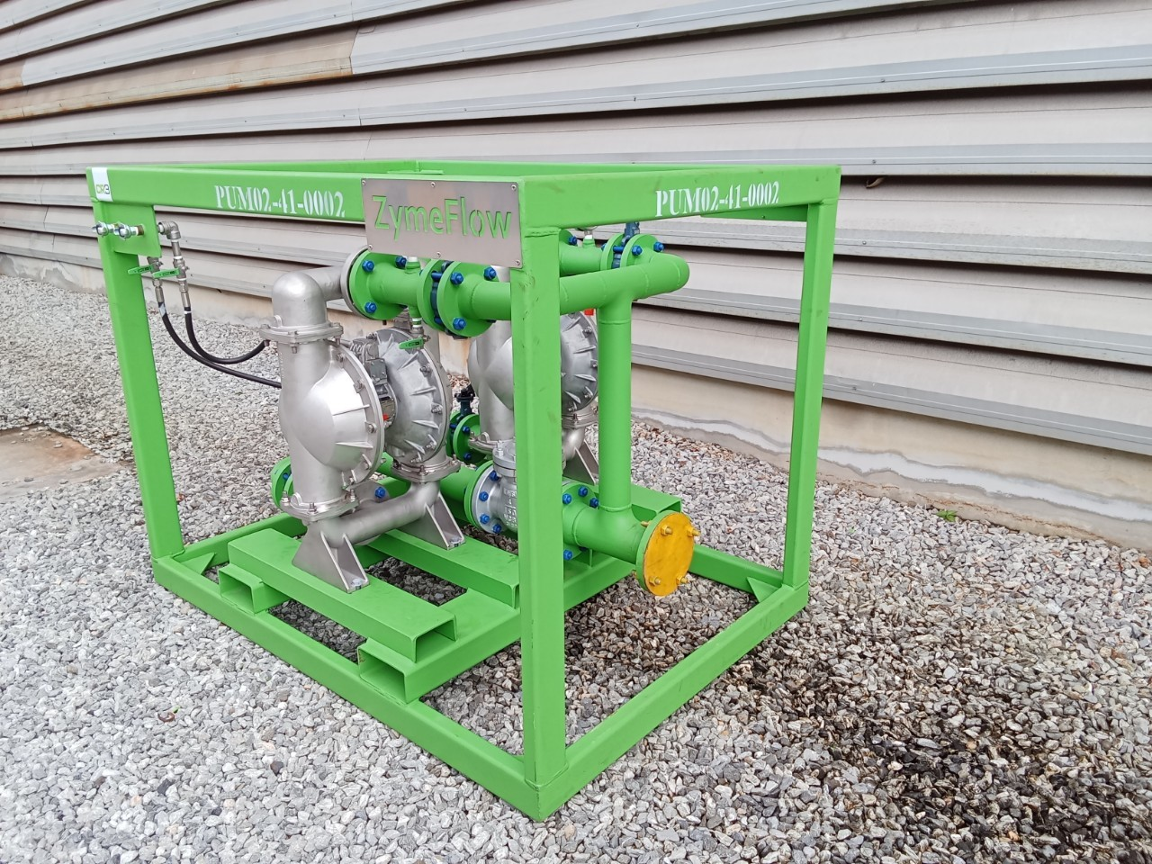
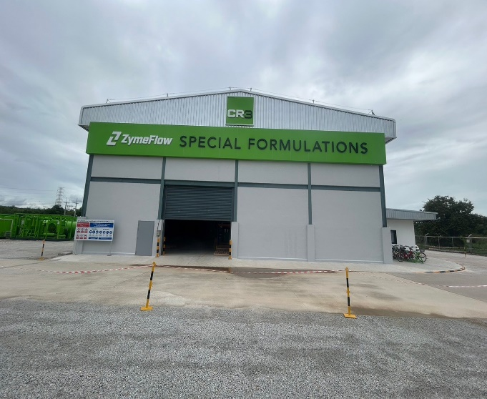
Decontamination Service
Chemical Cleaning
Descaling
Rust removal
Decontamination
Hydrocarbon H2S,LEL
Mercury Hg
PFAS decon
Passivation
Pyrophoric FeS
AFFF contain PFAS removal
PFOA, PFOS, PFHxS

Slide 7
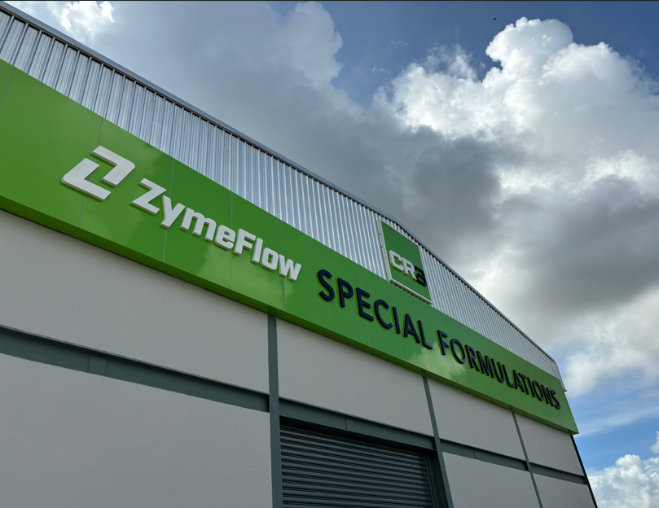
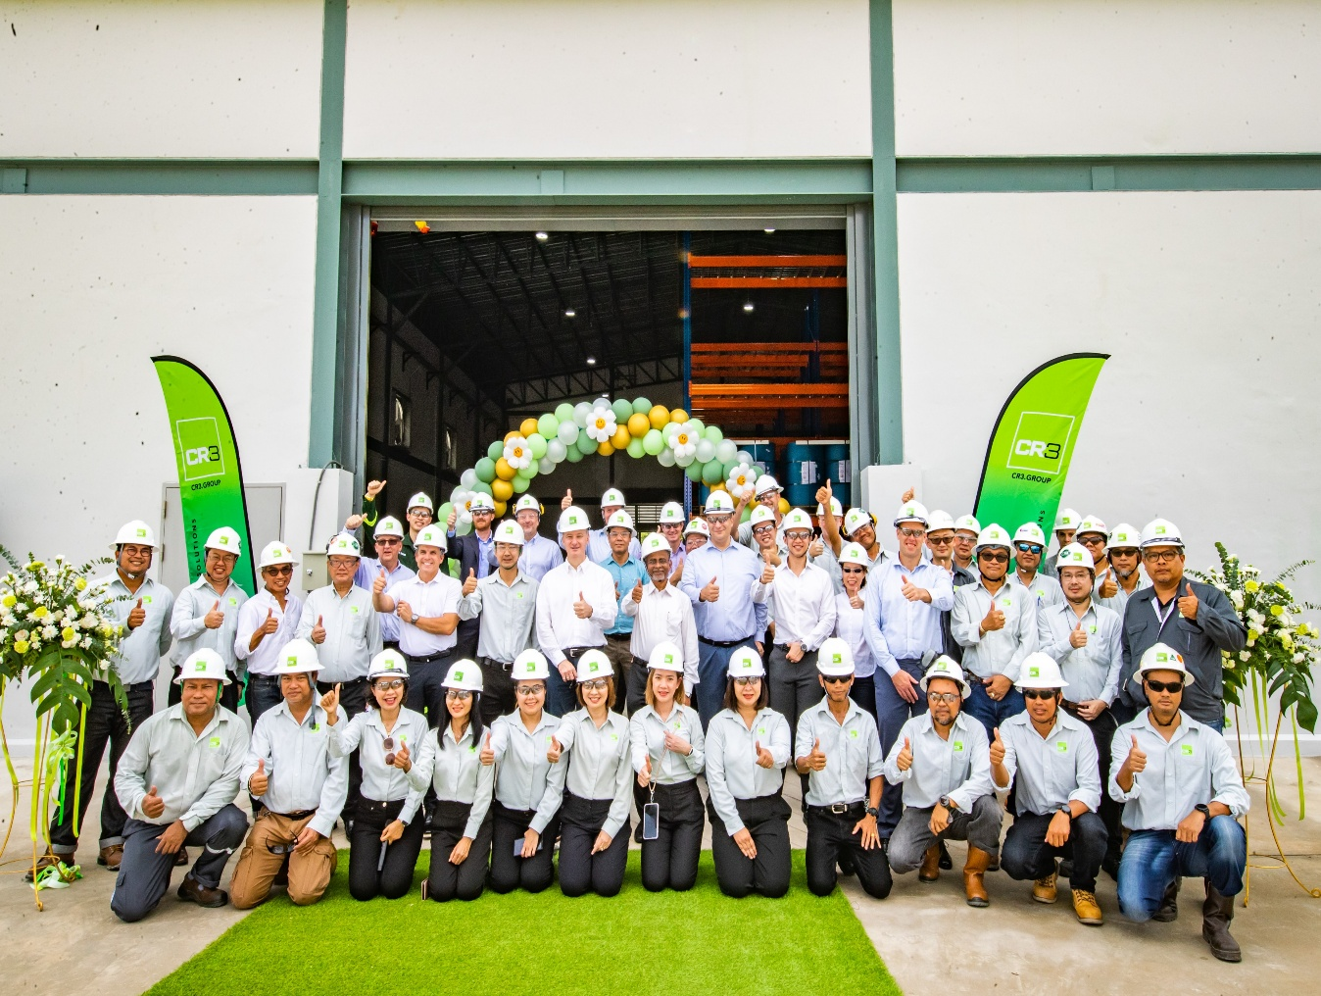
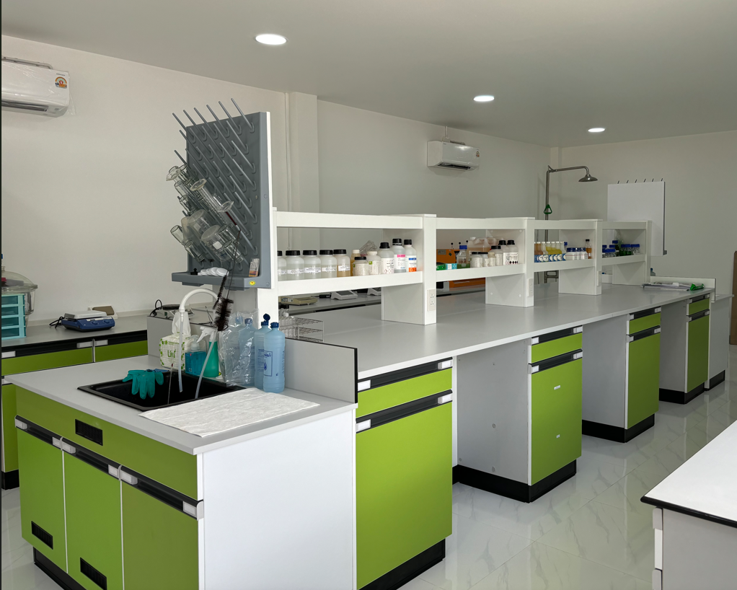
Chemicals Blending Facility

Slide 8
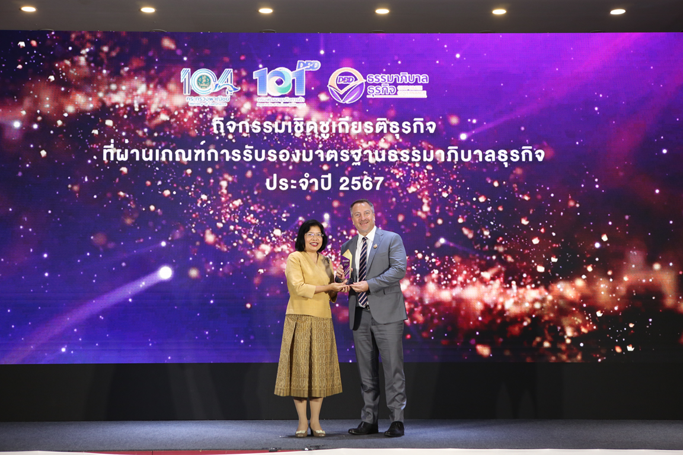


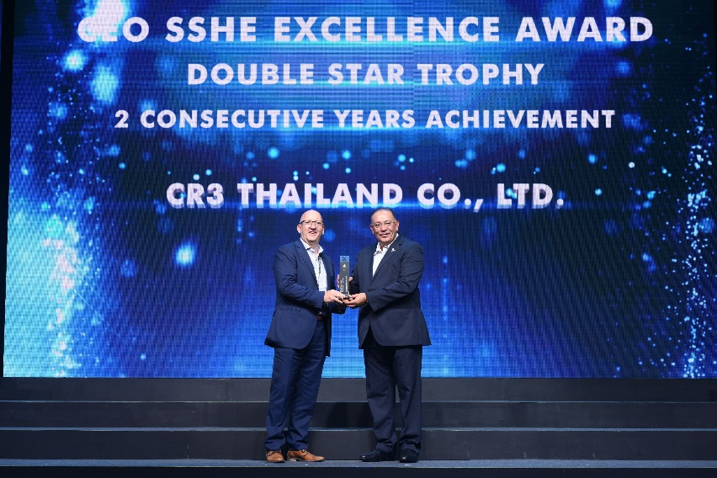

Award and Recognition
Good Governance Standards Certification
Presented by the Department of Business Development, Ministry of Commerce, Thailand, this esteemed recognition reinforces CR3’s dedication to robust governance principles, the rule of law, morality, transparency, participation, responsibility, and value creation.
We believe that exemplary governance and genuine sustainability are intrinsically linked. Our dedication to ethical practices ensures we not only pursue profitability but also uphold our responsibility towards environmental stewardship and the judicious, sustainable use of our planet’s natural resources.
Corporate Nation Building Awards
The prestigious CNB awards received by CR3 Thailand serve as a powerful validation of our commitment to making a tangible difference in the communities we operate within.
This award is not simply a recognition of good intentions; it is an acknowledgment of the measurable and impactful results achieved through our dedicated efforts.
We have consistently strived to create positive change through initiatives addressing pressing community needs, resulting in demonstrable improvements in education, infrastructure, and environmental sustainability.
Green Industry Level 4 Certification
Green Industry Level 4 Certification mandates that companies comply with environmental regulations and deeply embed sustainability into their core operations and culture.
This involves proactively implementing eco- friendly practices, actively engaging employees and the community in environmental initiatives, and demonstrating a firm commitment to continuous improvement.
CR3 Thailand’s successful renewal highlights its commitment to sustainability and sets a strong example for other businesses aiming to contribute to a greener future.
“CR3 Thailand is proud to be recognised for our commitment to strong governance, positive community impact, and environmental leadership. These awards demonstrate our holistic approach to responsible business. We will continue to improve our practices, ensuring ethical operations, building stronger communities, and driving sustainable solutions for lasting success.”
Gavin Ames
General Manager, CR3 Thailand.
Notes:
CR3T ได้รับการรับรองอุตสาหกรรมสีเขียวระดับ 4 วัฒนธรรมสีเขียว (Green Culture)

Slide 9


CR3 is continuing develop our service platform to support customers to meet their ESG target.
We are delighted to have the opportunity to share with you today our approach to driving ESG (Environmental, Social, and Governance) in our business operations as we strive for continuous improvement and excellence.
The PFAS Decontamination Service is one of our focusing.
LETS GET STARTED

Slide 10
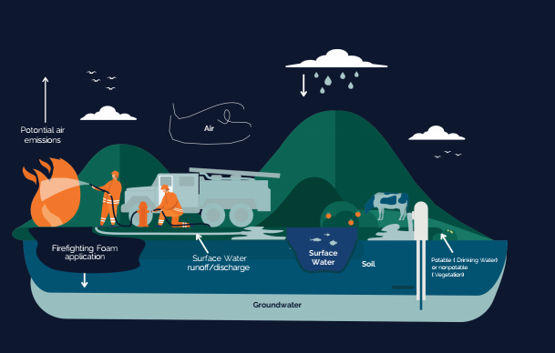
Consequences of PFAS Waste
Human
Exposure of high levels of PFAS as a result of
local water contamination has for example demonstrated a correlation with:
Impaired immune system
Changes in liver enzymes
Increase risk of kidney and testicular cancer
Increase risk of high blood pressure or pre-eclampsia in pregnant women
Nature
Soil may be contaminated with PFAS, leading to further contamination with everything in contact with the soil
Air, PFAS can be emitted into the air as vapors or particles. PFAS travels in the atmosphere through adhesion to particulate matter
Fish and wildlife, some PFAS are known to accumulate in exposed animals. It has also been shown to be a biomagnifier meaning the chemicals transfer up the food chain

Slide 11

Application to Industry sectors
Industry Sectors : best practice for firetrucks, fire extinguishers and sprinkler systems

Slide 12
Decontamination PFAS
Small system/low contamination
- Water Flushing
2. Big system/High
contamination
Special Chemical
Flushing

Slide 13
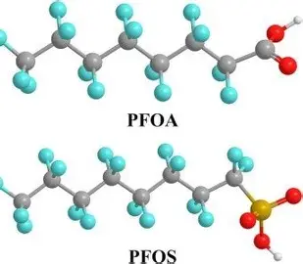
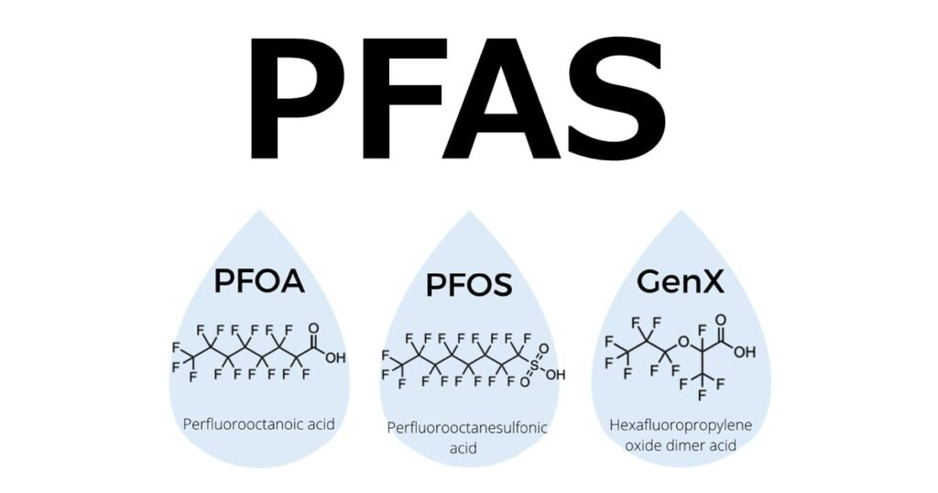
Lab Foam Testing
How is clean enough?
Send sample to certified laboratory by third party
To monitor parameter are PFOA, PFOS, PFHxS
3. The acceptance criteria as showed in below
  Limit PFOA less than 25 ppb
  Limit PFOS less than 10 ppm
  Limit PFHxS less than 25 ppb

Slide 14
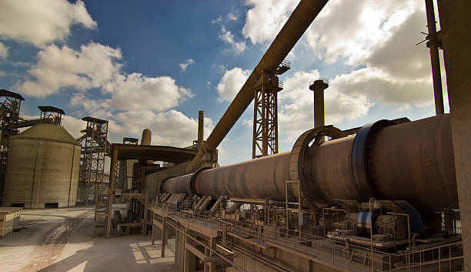
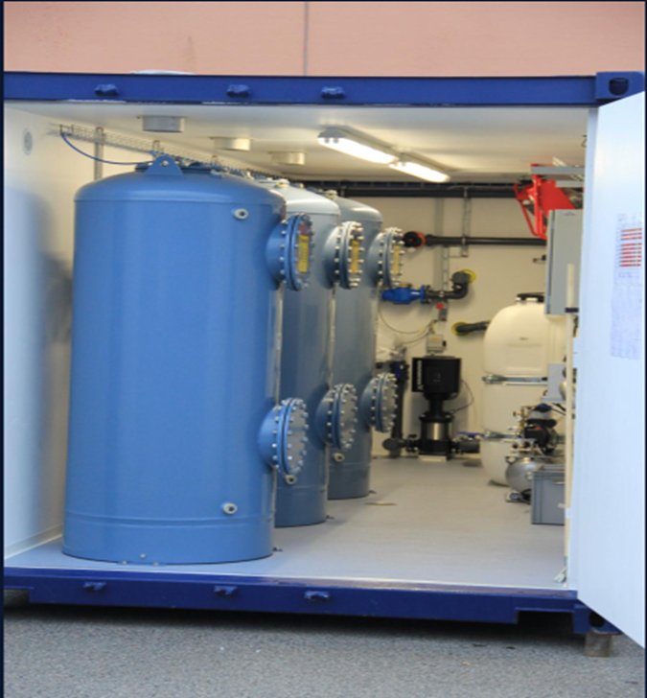
Waste Disposal
How to manage the disposal waste contain PFAS
Option 1
Disposal by coprocessing in cement Kiln with
incineration capacity 1400 C
Option 2
Filter system to purify process water from
sanitation and delivering water quality
to water standards

Slide 15
Sanitation Fire Extinguishers
Sanitation fire extinguishers
Volume: 6 liters each
Ages: 16 years
Media: PFOS contaminated

Slide 16
Sanitation Industrial facility system
Sanitation industrial facility system
Objects: Tank, Piping and Sprinklers
Ages: System installed 30+ years, foam media introduced 20+ years
Media: No pre-test was conducted. The customer was positive it contained high level of PFOS contaminated.

Slide 17
Sanitation Commercial Ferry
Sanitation commercial ferry
Objects: Tank, Piping and Sprinklers
Ages: Unknown, customer estimation 20+ years
Media: No pre-test was conducted. The customer was positive it contained high level of PFOS contaminated.

Slide 18
Thank you

